Slide 1
Performance Measures
By Nilesh Ghavate

Slide 2
Outline
Performance Measures :
Speedup,
execution time,
efficiency,
cost,
scalability,
Effect of granularity on performance,
Scalability of Parallel Systems,
Amdahl‘s Law, Gustavson‘s Law,
Performance Bottlenecks.

Slide 3
Introduction
Sequential algorithm -> execution time -> size of its input
Parallel algorithm -> input size + no. of processors + IPC
Always there’s some loss in accuracy
A parallel system is the combination of an algorithm and the parallel architecture on which it is implemented.

Slide 4
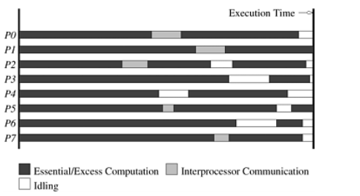
Sources of Overhead in Parallel Programs
Fig: The execution profile of a hypothetical parallel program executing on eight processing elements

Slide 5
Sources of overhead
1) Interprocess Interaction (most significant)
2) Idling
arised due to improper load balance,
synchronization,
presence of serial components in a program.
3) Excess Computation
The difference in computation performed by the parallel program and the best serial program.

Slide 6
Performance Metrics
Execution Time
Total Parallel Overhead
SpeedUp
Efficiency
Cost
Scalability

Slide 7
Execution Time
TS : The serial runtime of a program is the time elapsed between the beginning and the end of its execution on a sequential computer.
Tp : The parallel runtime is the time that elapses from the moment a parallel computation starts to the moment the last processing element finishes execution.
Ttotal = p * Tp

Slide 8
Total Parallel Overhead
It is the total time collectively spent by all the processing elements over and above that required by the fastest known sequential algorithm for solving the same problem on a single processing element.
To =(p x Tp) - Ts

Slide 9
Speedup
Performance gain is achieved by parallelizing.
Definition of Speedup:
Speedup (S) = Time taken by the serial algorithm / Time taken by the parallel algorithm.
Speedup (S) = Ts /Tp

Slide 10

Example Adding n numbers using n processing elements
Time for single processing unit : O(n)
16 processor & 16 numbers
Inter process communication : 15

Slide 11
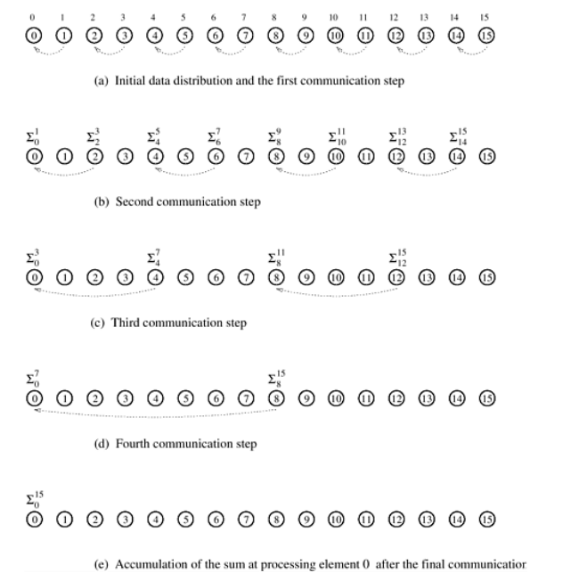
Example Adding n numbers using n processing elements
We can perform this operation in log n steps by propagating partial Sums up a logical binary tree of processing elements
Time for parallel processing unit : O(log n)
16 processor & 16 numbers
Inter process communication : 15
Computing the globalsum of 16 partial sums using 16 processing elements

Slide 12
Example Adding n numbers using n processing elements
Speedup : O(n) / O(log n)

Slide 13
Example : Sorting elements
Serial Bubble Sort: The given bubble sort takes 150 seconds to sort 10^5 records.
Serial Quicksort: An alternative sorting algorithm, quicksort, can sort the same records in 30 seconds, which is significantly faster and represents the best serial algorithm for this case.
Parallel Odd-Even Sort: The parallel version of bubble sort (odd-even sort) takes 40 seconds using 4 processing elements.

Slide 14
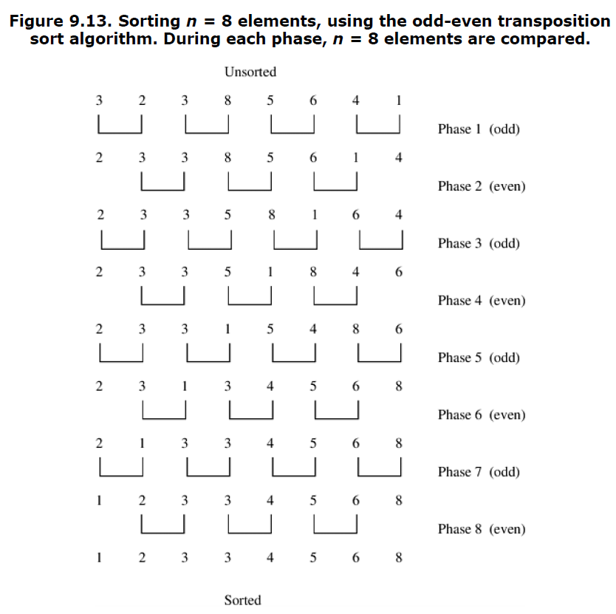

Slide 15
Example : Sorting elements
Misleading Speedup Calculation:
If you compare the parallel odd-even sort to the serial bubble sort:
Speedup =150/40=3.75.
This comparison is invalid because bubble sort is not the best serial algorithm for this task.
Correct Speedup Calculation:
Speedup must be measured against the best serial algorithm (quicksort in this case):
Speedup =30/40=0.75.

Slide 16
Example : Sorting elements
Speedup should always be measured relative to the best serial algorithm to reflect true performance gains.
The parallel odd-even sort is less efficient than the best serial quicksort, achieving a speedup < 1.
This highlights the importance of choosing optimal algorithms for both serial and parallel implementations.

Slide 17
Important points
Theoretical maximum speedup = P (number of processing elements).
Maximum Speedup Condition: Each processing element must work perfectly and take no more than TS/p time. Assuming NO Overhead ( partition , communication, synchronization overhead)
Serial running time = ts
Parallel running time = ts /p.
Speedup
S(n) = ts /(ts /p) =p (ideal linear speedup)
Why Speedup > P is Unrealistic:
Implies each processing element works faster than TS/p.
Suggests the problem could be solved in less than TS time using a single processing element.
This contradicts the definition of TS as the runtime of the best sequential algorithm.

Slide 18
Important points
Speedup greater than p violates theoretical bounds and is not possible in practice.
Speedup S≤ P in realistic scenarios.
What is Superlinearity ?
Superlinearity refers to a situation in parallel computing where the speedup achieved by parallelizing a problem is greater than the number of processing elements used, or greater than the speedup predicted by a simple linear scaling model.

Slide 19
Initial Conditions for a Single Processor (Cache Hit 80%):
A single processor solves a problem of size W.
Cache hit ratio: 80%, meaning 80% of memory accesses hit the cache, and the remaining 20% access main memory (DRAM).
Cache latency: 2 ns and DRAM latency: 100 ns.
Effective memory access time (Teff):
Calculation: 2×0.8+100×0.2=21.62 ns.

Slide 20

The processing rate is 46.3 MFLOPS (million floating-point operations per second) because each memory access corresponds to one FLOP.

Slide 21
Parallel Execution with Two Processors (Problem Size W/2 on Each Processor):
Now, the problem is split into two processors, each working on half of the problem size W/2.
Since the problem size is smaller, cache hit ratio improves due to the reduced data working set:
Cache hit ratio: 90%, which is higher than the single processor case (80%).
8% of remaining data comes from local DRAM and 2% from remote DRAM.
Remote DRAM latency: 400 ns (due to communication between processors).

Slide 22
Effective memory access time(Teff):
Calculation: 2×0.9 + 100×0.08 + 400×0.02 =17.82 ns.
The execution rate for each processor increases to 56.18 MFLOPS, leading to a total execution rate of 112.36 MFLOPS (for both processors combined).

Slide 23
Superlinear Speedup:
112.36 / 46.3 = 2.43 , which is greater than 1 (executing rate not time /speed)
Or
21.6 *10^9 / 17.8 * 10^9 = 1.213 (Speed), which is greater than 1
Cause of superlinear speedup:
The improved cache hit ratio from reducing the problem size per processor leads to better memory access times, which accelerates computation beyond the expected linear speedup.

Slide 24
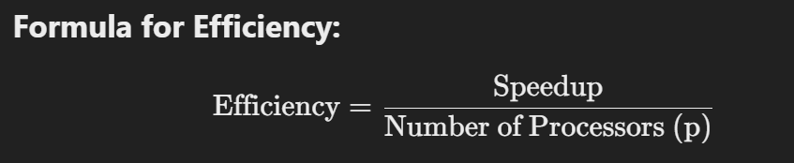
Efficiency
Efficiency in High-Performance Computing (HPC) is a measure of how effectively the computational resources (such as processors, memory, etc.) are utilized to solve a given problem.
It helps to quantify the performance of a parallel system relative to the ideal performance.

Slide 25
Efficiency
Ideal Efficiency:
The ideal efficiency is 1 (or 100%), meaning there is no overhead, and each processor contributes equally to the computation.
For this to happen, the workload must be perfectly divisible with no communication overhead between processors.

Slide 26
Efficiency
Real Efficiency:
In practice, efficiency is often less than 100% because of various factors such as:
Communication overhead
Synchronization overhead
Load imbalance
Memory contention

Slide 27
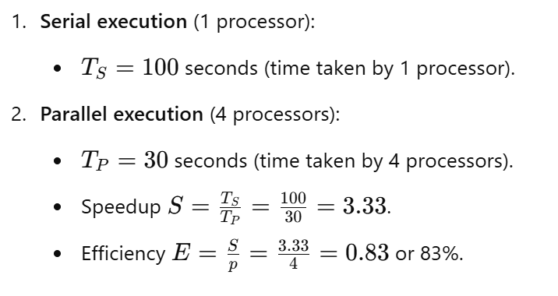
Example of Efficiency:
This means that even though four processors are used, the system is operating at 83% efficiency. The remaining 17% is likely due to communication overhead, load imbalance, or other factors.

Slide 28

Cost
Cost of Solving a Problem on a Single Processor: execution time of the fastest known sequential algorithm.
Cost of Solving a Problem on a Parallel System:
This reflects the total time spent by all processing elements to solve the problem, and it measures the work done by the system.

Slide 29
Cost-Optimal Parallel System
A cost-optimal parallel system is one where the cost of solving the problem on the parallel system grows asymptotically at the same rate as the sequential execution time (i.e., the fastest-known sequential algorithm).
This means that, for large problem sizes, the parallel system will scale efficiently and the increase in cost will be proportional to the problem size.

Slide 30
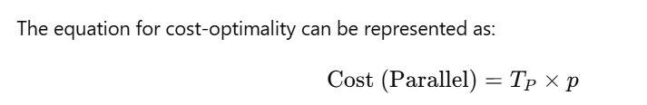
Cost-Optimal Parallel System:

Slide 31
Efficiency of a Cost-Optimal Parallel System:
The cost-optimal parallel system to maintain Q(1) efficiency means that the efficiency of the parallel system remains constant even as the number of processing elements (processors) increases. In other words, the system continues to achieve the same level of efficiency, regardless of how many processors are added.
There is no performance degradation as more processors are added.

Slide 32
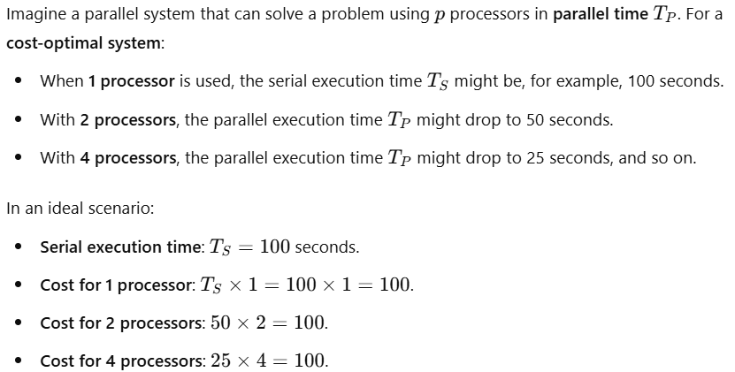
Example of a Q1 Efficiency:
There are no significant overheads from communication or synchronization, allowing the system to maintain high scalability and optimal performance.

Slide 33
Scalability
Scalability refers to the ability of a system to handle a growing amount of work or its potential to be enlarged to accommodate that growth.
In the context of HPC, scalability is the system's capacity to maintain or improve performance as more computational resources (like processors or nodes) are added to solve larger or more complex problems.

Slide 34
Types of Scalability in HPC:
Strong Scalability:
Definition: Strong scalability measures how the parallel system performs as the problem size remains constant, but the number of processors (or computational resources) increases.
Goal: The goal is to reduce the execution time of the fixed-size problem by distributing it across more processors.
Ideal Scenario: In an ideal case, the execution time should decrease linearly as more processors are added.
Example: Sorting a large dataset.
Scenario: The problem size (dataset) remains constant, and you add more processors to speed up the sorting.

Slide 35
Types of Scalability in HPC:
Weak Scalability:
Definition: Weak scalability measures how the parallel system handles a larger problem size when the number of processors increases.
Goal: The goal is to solve a larger problem in the same amount of time by increasing both the problem size and the number of processors.
Ideal Scenario: In an ideal case, the problem size should scale proportionally with the number of processors, and the execution time should remain roughly constant as more resources are added.
Example:Increasing the size of a matrix in a numerical simulation while adding more nodes to keep the execution time constant.

Slide 36
Types of Scalability in HPC:
Linear Scalability:
Definition: Linear scalability means that the execution time decreases inversely proportional to the number of processors.
Ideal Scenario: If you double the number of processors, the time required to solve the problem is halved.
Example: A perfect case where the system's speedup is exactly proportional to the number of processors.

Slide 37
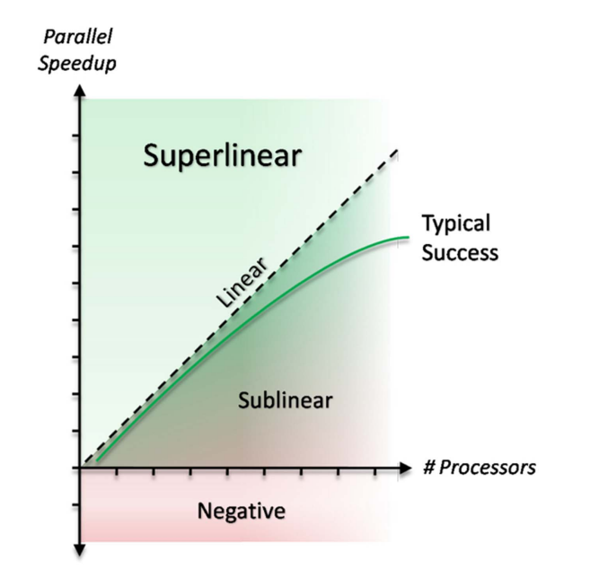

Slide 38
Types of Scalability in HPC:
Superlinear Scalability:
Definition: Superlinear scalability occurs when the system's performance increases more than linearly as the number of processors increases. This is unusual but can happen under certain conditions, such as:
Reduced memory access time
Optimized memory access patterns
Example: A parallel system that exhibits faster-than-expected performance as more processors are added, often due to improved cache efficiency or better load balancing.

Slide 39
Types of Scalability in HPC:
Sublinear Scalability:
Definition: Sublinear scalability occurs when the system's performance increases at a rate slower than linear as processors are added. This indicates inefficiency, where adding more resources does not significantly improve performance.
Causes:
Communication overhead
Synchronization overhead
Memory contention

Slide 40
Speedup Analysis
Recall speedup definition: Ψ(n,p) = t_{s}/t_{p}
A bound on the maximum speedup is given by
Inherently sequential computations are σ(n)
Potentially parallel computations are ϕ(n)
Communication operations are κ(n,p)
The “≤” bound above is due to the assumption in formula that the speedup of the parallel portion of computation will be exactly p.
Note κ(n,p) = 0 for SIMDs, since communication steps are usually included with computation steps.

Slide 41
The Effect of Granularity on Performance
Initial Parallel Algorithm:
The algorithm assumes one processing element per input, which is excessive in real-world scenarios.
Instead, we group multiple input elements per processing element, increasing the granularity of computation.
Scaling Down a Parallel System:
Instead of having n processing elements for n inputs, we use only p processing elements (p < n).
Each processing element now handles n/p inputs.

Slide 42
The Effect of Granularity on Performance
Impact on Computation & Communication:
Each processing element does more work, increasing its computational load by a factor of n/p i.e (1* n/p).
Communication time decreases by the factor of n/p.
Computation increases by the factor of n/p.
So the total parallel runtime also increases by at most a factor of n/p, meaning the system does not become inefficient.
Cost-Optimality:
If the original system with n parallel processing elements was cost-optimal, then only scaled-down system remains cost-optimal.
However, if the original system was not cost-optimal, increasing computational granularity might not fix the issue.

Slide 43
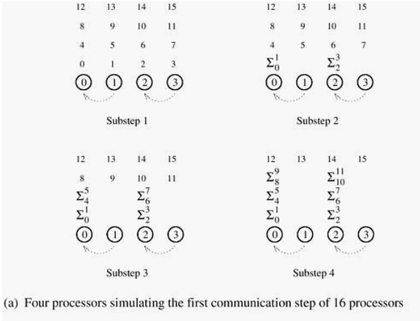
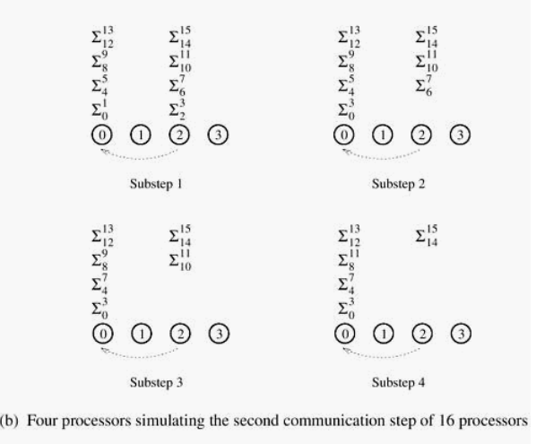
Illustrative Example – Adding n Numbers with p processor

Slide 44
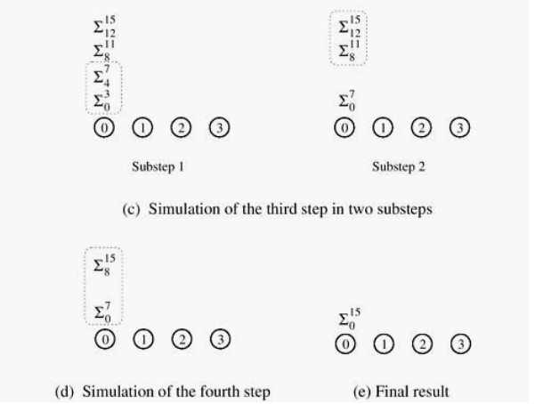
Illustrative Example – Adding n Numbers with p processor
p=4
n=16
4 processor & 16 numbers
Inter process communication : 12
This reduction in communication was not enough to make the algorithm cost-optimal.

Slide 45
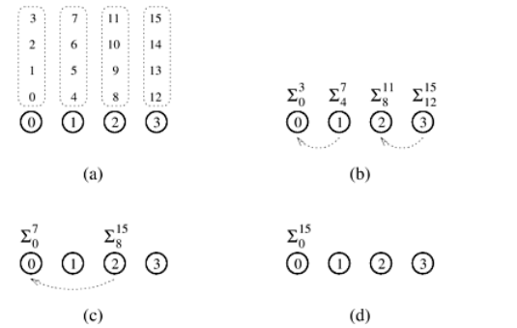
Illustrative Example – Adding n numbers cost-optimally
In the first step of this algorithm, each processing element locally adds its n/p numbers in time Θ(n/p). Here it is Θ(4).
Summing the Partial Sums in Parallel, since each step halves the number of sums, the total number of steps required is log₂ p, which can be done in time Θ(log p)
Total time is Θ(n/p + log p)
p=4
n=16
4 processor & 16 numbers
Inter process communication : 3

Slide 46
The Effect of Granularity on Performance
Cost Analysis
Cost is defined as the total work done across all processing elements, i.e.,
Cost = Parallel Runtime × Number of Processors
C = Tp x p
C = Θ( n/p + logp) x p = Θ(n + p logp)
Cost-Optimality Condition
A parallel algorithm is cost-optimal if its total cost matches the best-known serial runtime, which is Θ(n) for summation.
This holds if and only if:
n=Ω(p log⁡ p)
This condition ensures that the additional overhead from parallelism (p logp) does not dominate the cost.

Slide 47
The Effect of Granularity on Performance
Execution time for parallel portion ϕ(n)/p
time
processors

Slide 48
The Effect of Granularity on Performance
Time for communication κ(n,p)
time
processors

Slide 49
The Effect of Granularity on Performance
Execution Time of parallel portion ϕ(n)/p + κ(n,p)
time
processors

Slide 50
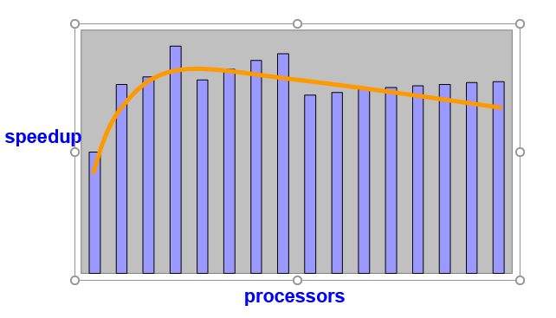
Scalability of Parallel Systems

Slide 51
Scalability of Parallel Systems -Amdahl’s Law
Let f be the fraction of operations in a computation that must be performed sequentially, where 0 ≤ f ≤ 1.
The maximum speedup ψ
achievable by a parallel computer with n processors is

Slide 52
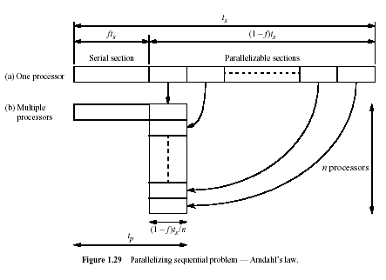
Usual Argument: If the fraction of the computation that cannot be divided into concurrent tasks is f, and no overhead incurs when the computation is divided into concurrent parts, the time to perform the computation with n processors is given by t_{p} ≥ ft_{s} + [(1 - f )t_{s}] / n, as shown below:

Slide 53
Derivation of Amdahl’s Law (cont.)
Using the preceding expression for t_{p}
The last expression is obtained by dividing numerator and denominator by t_{s} , which establishes Amdahl’s law.
Multiplying numerator & denominator by n produces the following alternate versions of this formula:

Slide 54
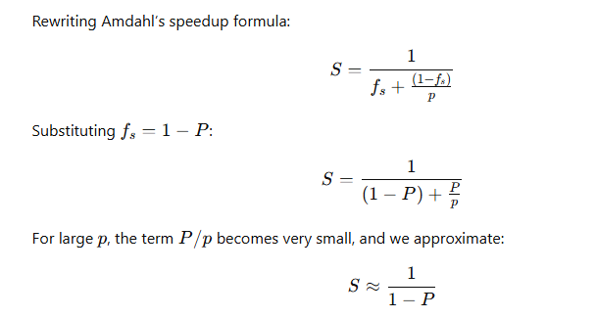
Potential Benefits, Limits and Costs of Parallel Programming Amdahl's Law
P represents the parallel fraction & fs represents the serial fraction of the workload. Whereas fs+ P =1
Amdahl's Law states that potential program
speedup is defined by the fraction of code (P) that can be parallelized:
if none of the code can be parallelized, P = 0 and the speedup = 1 (no speedup).
If all of the code is parallelized, P = 1 and the speedup is infinite (in theory).
If 50% of the code can be parallelized, maximum speedup = 2, meaning the code will run twice as fast.

Slide 55
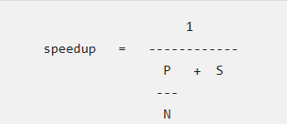
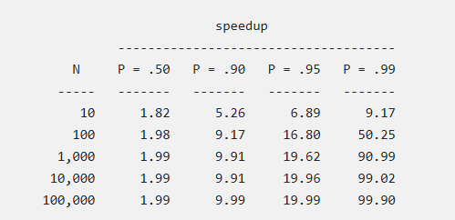
Potential Benefits, Limits and Costs of Parallel Programming Amdahl's Law
Introducing the number of processors performing the parallel fraction of work, the relationship can be modeled by:
where
P = parallel fraction,
N = number of processors and
S = serial fraction
It soon becomes obvious that there are limits to the scalability of parallelism.

Slide 56
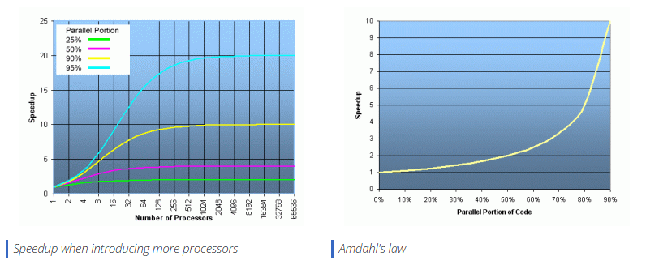
Potential Benefits, Limits and Costs of Parallel Programming Amdahl's Law

Slide 57



Amdahl’s law and Strong Scaling
Provides a way to quantify the theoretical maximum speedup in latency that can occur with parallel execution.
Amdahl’s law describes the ratio of the original execution time with the improved execution time, assuming perfect parallelism and no overhead penalty.
That is, Amdahl’s law provides a theoretical limit to how much faster a program can run if it is parallelized.

Slide 58

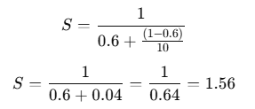
Amdahl’s Law
Suppose a parallel program is executing on 10 processors, and only 40% of the time is executing in parallel.
What is the overall speedup gained by incorporating parallelism?
Formula for Speedup (Amdahl’s Law):
Thus, the program runs 1.56 times faster, meaning a 56% improvement in execution time.

Slide 59
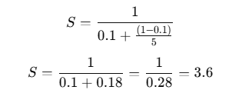
Amdahl’s Law Example
If 90% of a calculation can be parallelized (10% is sequential), then the maximum speedup achieved on 5 processors is:
Formula for Speedup (Amdahl’s Law):
Thus, the program runs 3.6 times faster.
Speedup for More Processors
On 10 processors → Speedup = 5.3
On 20 processors → Speedup = 6.9
On 1000 processors → Speedup = 9.9
Even with 1000 processors, the maximum achievable speedup is only 9.9× due to the serial portion of the program.

Slide 60
Amdahl’s Law Example
95% of a program’s execution time occurs inside a loop that can be executed in parallel. What is the maximum speedup we should expect from a parallel version of the program executing on 8 CPUs?

Slide 61
Amdahl’s Law Example
5% of a parallel program’s execution time is spent within inherently sequential code.
The maximum speedup achievable by this program, regardless of how many PEs are used, is

Slide 62

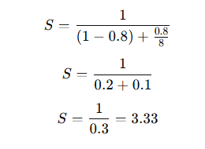
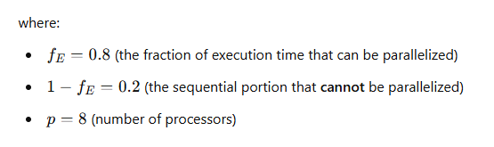
Amdahl’s Law Example
An oceanographer gives you a serial program and asks you how much faster it might run on 8 processors.
You can only find one function amenable to a parallel solution. Benchmarking on a single processor reveals 80% of the execution time is spent inside this function.
What is the best speedup a parallel version is likely to achieve on 8 processors?

Slide 63
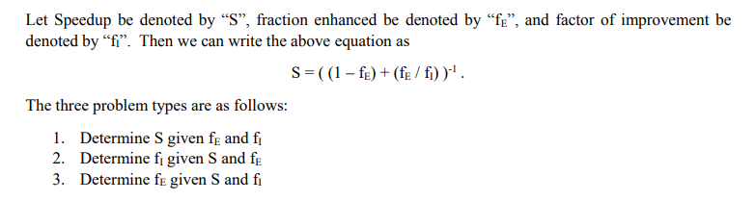

Amdahl’s Law

Slide 64
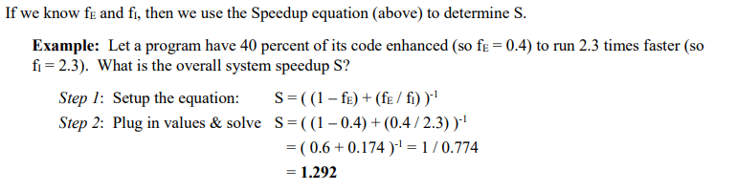
Problem Type 1 – Predict System Speedup

Slide 65
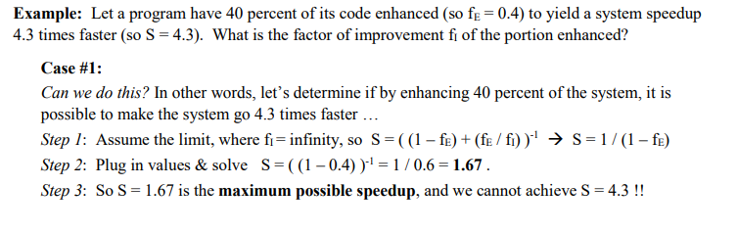
Problem Type 2 – Predict Speedup of Fraction Enhanced

Slide 66
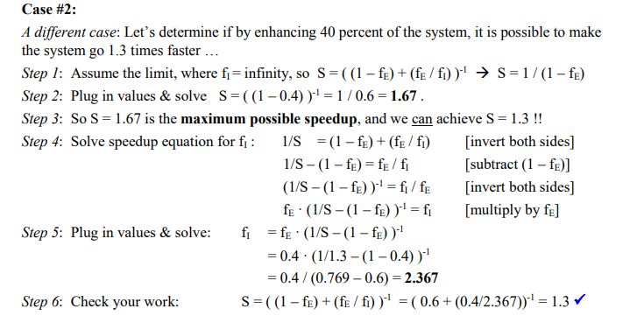
Problem Type 2 – Predict Speedup of Fraction Enhanced

Slide 67
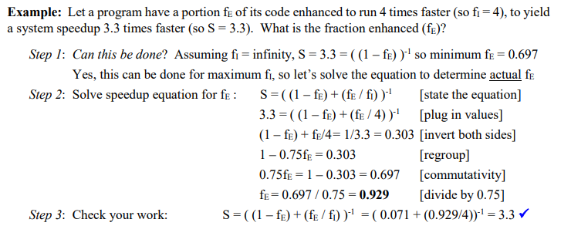
Problem Type 3 – Predict Fraction of System to be Enhanced

Slide 68
Amdahl’s Law
Amdahl’s Law assumes a fixed problem size.
It focuses on the speedup limitations due to the sequential portion of a program.
Even with infinite processors, speedup is limited by the serial fraction F.
Key takeaway: Parallelism is bounded by the serial portion, making large processor counts inefficient if F is significant.

Slide 69
Gustafson’s Law
Gustafson’s Law assumes a growing problem size.
It argues that as we add more processors, we can handle larger problems, making parallelism more useful.
Unlike Amdahl’s Law, speedup scales better because parallel work increases with the number of processors. Not tied solely to the parallelism.
It is termed as Weak Scaling
Key takeaway: More processors can increase problem size, making parallelization more effective.

Slide 70
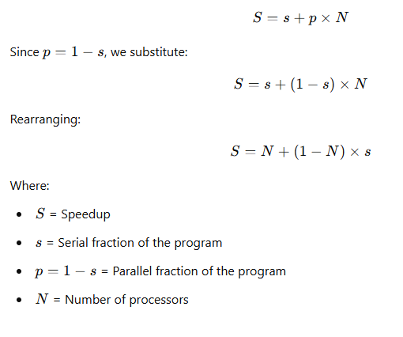
Gustafson’s Law Formula

Slide 71
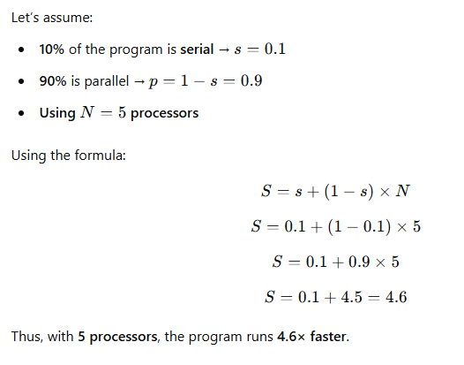
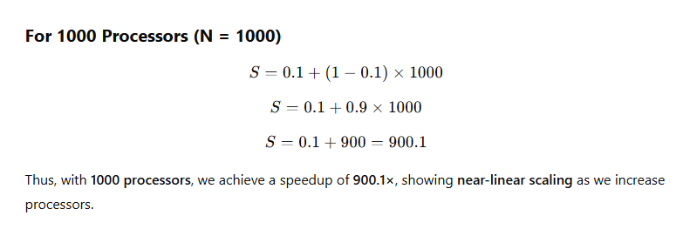
Gustafson’s Example
It's also known as "scaled speedup".

Slide 72
Gustafson’s Example
As an example, consider a program that can be partially improved with parallel execution.
Let us assume that 20% of the program cannot be improved and some initial empirical results suggest that the parallel execution portion runs in 1/5​th of the time that it takes sequentially (i.e., an improvement factor of 5).
Note that this does not assume anything about how many processors are used, so it can be based on more realistic measurements by running some initial tests.
In this case, the speedup would be:
S= 0.2 + 5 ∗0.8 = 0.2 + 4.0 = 4.2
The proper interpretation of the Gustafson’s law notion of speedup is that this program can achieve 4.2 times as much work in the same amount of time, which is based on weak scaling.
If the original program could process 10 MB of data in a minute, then the improved version could process 42 MB in the same amount of time.
With Gustafson’s law, the emphasis is on the throughput (amount of work done) rather than a faster time.

Slide 73
Scalability of Parallel Systems
Increase number of processors → decrease efficiency
Increase problem size → increase efficiency
Can a parallel system keep efficiency by increasing the number of processors and the problem size simultaneously???
Yes: → scalable parallel system
No: → non-scalable parallel system
A scalable parallel system can be made cost-optimal by balancing the number of processors with problem size.

Slide 74
Scalability of Parallel Systems
Scalability of a parallel system - a measure of its ability to increase performance as number of processors increases
A scalable system maintains efficiency as processors are added
Isoefficiency - a way to measure scalability
It helps determine how the problem size must grow to maintain a constant efficiency as the number of processors increases
or
Isoefficiency tells us how much we need to increase the problem size as we add processors to keep efficiency constant.

Slide 75

Why is Isoefficiency Important?
Adding more processors does not always lead to better performance due to communication overhead and sequential bottlenecks (Amdahl’s Law).
Efficiency (E) is defined as:
Isoefficiency function W=f(p) determines how the problem size W(total work) must scale with p to maintain a fixed efficiency.
If the problem size does not grow fast enough, adding processors leads to poor scalability.

Slide 76
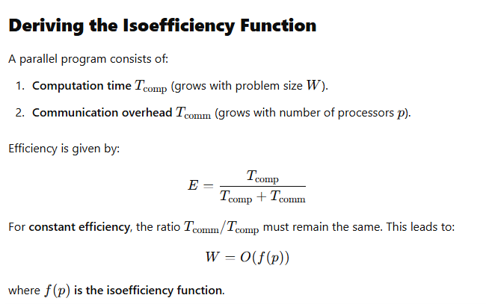
The lower f(p), the better the scalability.

Slide 77
Types of Isoefficiency Growth
The growth of W with respect to p depends on how communication overhead scales.
Linear Isoefficiency: W=O(p)
If communication overhead is minimal, the problem size needs to increase linearly with processors.
Logarithmic Isoefficiency: W=O(plog⁡p)
If communication grows logarithmically, the problem size must grow slightly faster than O(p).
Quadratic Isoefficiency: W=O(p2)
If communication overhead grows faster, problem size must grow quadratically to maintain efficiency.

Slide 78
Factors That Limit Parallel Execution
1. Load Imbalance: When tasks are not evenly distributed among processors, some finish early while others are still computing, leading to idle time and reduced efficiency. For example, in parallel sorting, if one processor receives more data, it takes longer to complete, delaying the overall process.
2. Serialization: Some parts of a program must run sequentially, limiting parallel execution and slowing performance. For instance, a critical section in a parallel program that only one processor can access at a time forces others to wait.
3. Communication Overhead: Processors need to exchange data, but excessive communication can slow execution. For example, in a distributed database, frequent synchronization between nodes can reduce overall performance.
4.Bottlenecks: Certain resources, like memory access, can become a limiting factor in performance. For instance, if multiple processors need to access the same memory location, contention can cause delays.

